Slide 1

Software Construction and Software Testing
TTTE6104
Software Engineering Paradigm

Slide 2
Objectives

Slide 3
Contents
Introduction to Software Construction
System Design
Programming
System Testing

Slide 4
Introduction to Software Construction
The Construction Phase in the Rational Unified Process includes:
  System design, programming, and testing.
  Development of different parts of the system in parallel.
  Integration of system components during this phase.
On completion of the Construction Phase:
  A working software system is produced.
  Associated documentation is prepared.
  The system is ready for delivery to users.

Slide 5
System Design
Architectural Design
  Defines the high-level structure of the system, identifying major components and how they interact.
  Common architectural styles: Client-server, Layered, Microservices, etc.
Component Design
  Decomposes the system into smaller, independent modules or components.
  Defines the responsibilities and interfaces of each component.
Data Design
  Defines how data will be structured, stored, and accessed.
  Includes designing databases, data flows, and data models.
  Ensures data integrity, consistency, and security.
Interface Design
  Defines how system components will communicate with each other.
  Ensures seamless integration between system modules and a user-friendly interface.

Slide 6
Architectural Design
The first stage in the software design process.
Architectural design is concerned with understanding how a system should be organized and designing the overall structure of that system.
The output of the architectural design process is an architectural model that describes how the system is organized as a set of communicating components.
As part of the requirements engineering process, you might pro- pose an abstract system architecture where you associate groups of system functions or features with large-scale components or sub-systems.

Slide 7
Two levels of abstraction software architectures
Architecture in the small
  concerned with the architecture of individual programs
  concerned with the way that an individual program is decomposed into components
Architecture in the large
  concerned with the architecture of complex enterprise systems that include other systems, programs, and program components

Slide 8
Advantages of explicitly designing and documenting software architecture
Stakeholder communication - The architecture is a high-level presentation of the system that may be used as a focus for discussion by a range of different stakeholders.
System analysis - Making the system architecture explicit at an early stage in the system development requires some analysis. Architectural design decisions have a profound effect on whether or not the system can meet critical requirements such as performance, reliability, and maintainability.
Large-scale reuse - A model of a system architecture is a compact, manageable description of how a system is organized and how the components interoperate.

Slide 9
Architectural views
A logical view, which shows the key abstractions in the system as objects or object classes. It should be possible to relate the system requirements to entities in this logical view.
A process view, which shows how, at run-time, the system is composed of inter- acting processes. This view is useful for making judgments about non- functional system characteristics such as performance and availability.
A development view, which shows how the software is decomposed for development, that is, it shows the breakdown of the software into components that are implemented by a single developer or development team. This view is useful for software managers and programmers.
A physical view, which shows the system hardware and how software components are distributed across the processors in the system. This view is useful for systems engineers planning a system deployment.

Slide 10
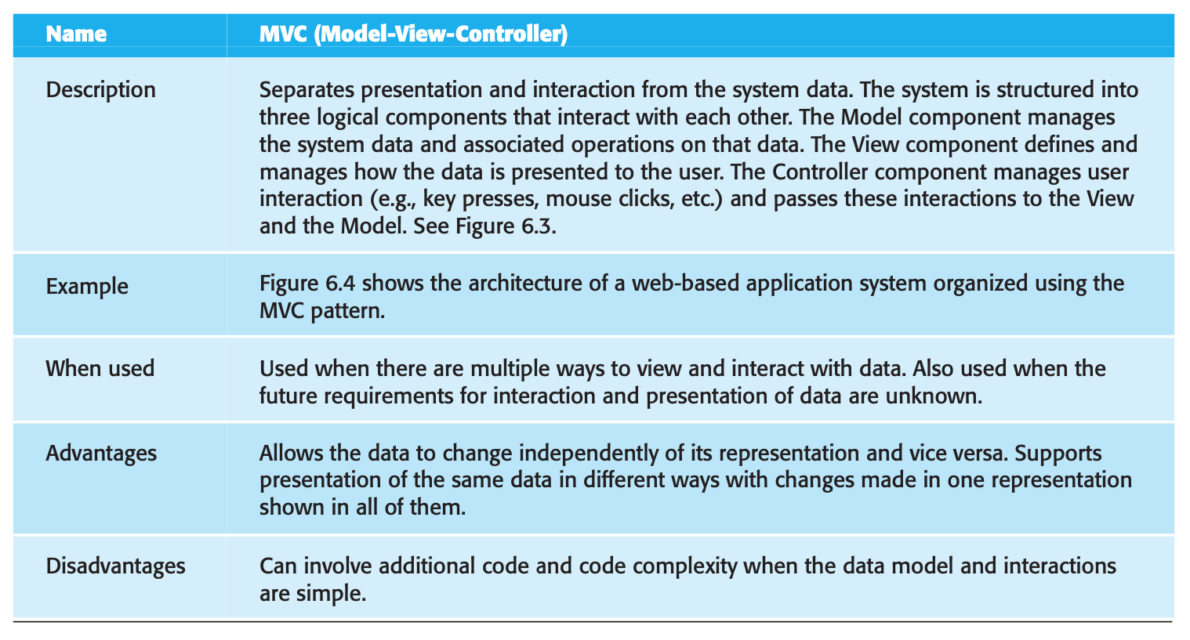
The model- view-controller (MVC) pattern

Slide 11
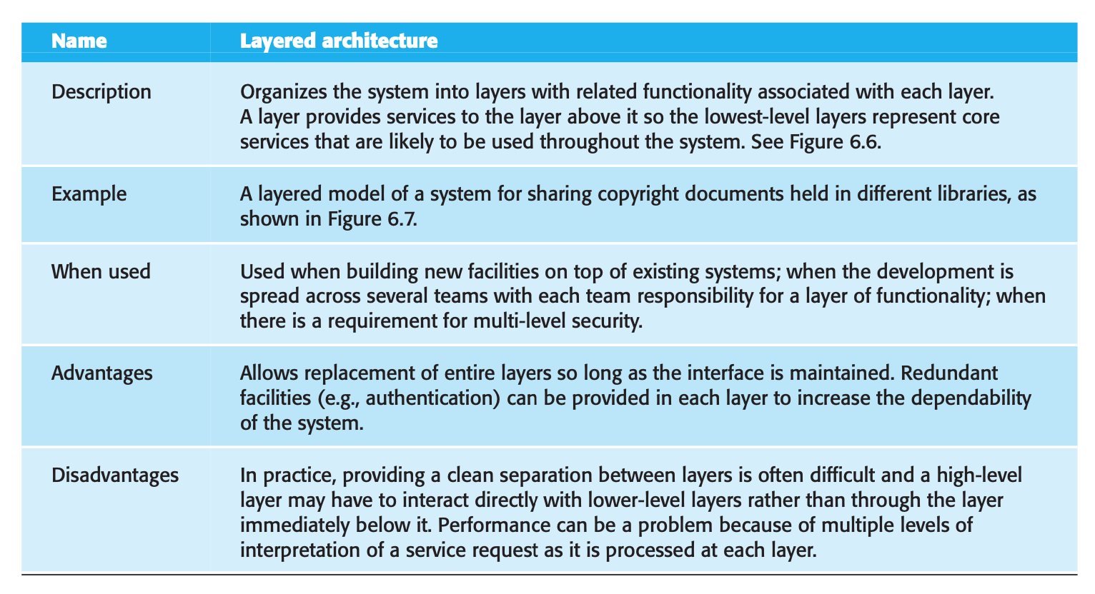
The layered architecture pattern

Slide 12
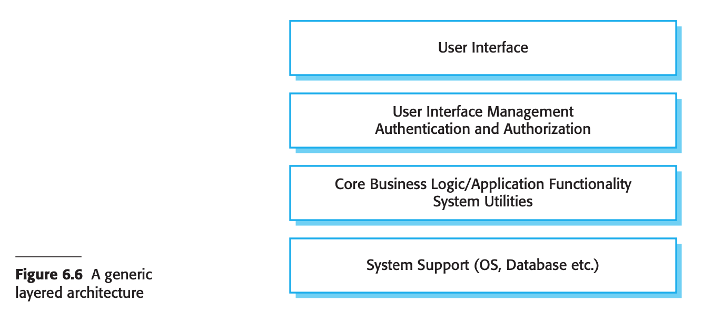
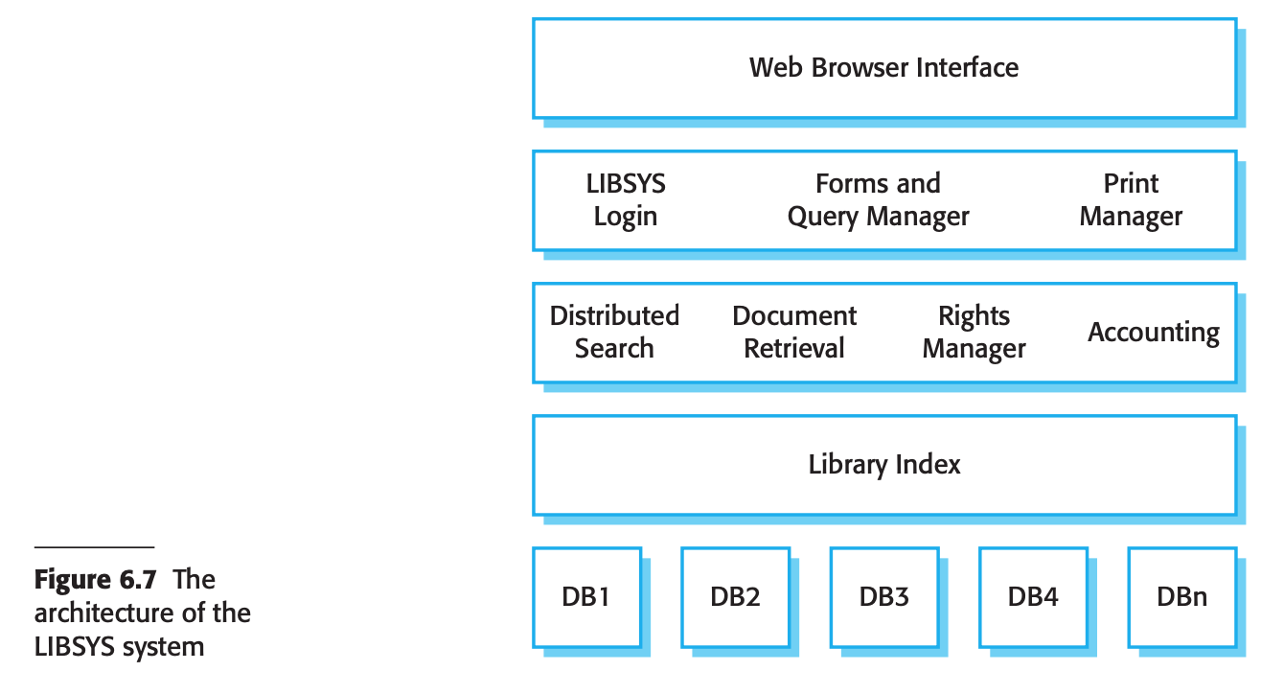

Slide 13
Other Architecture
Repository architecture
Client–server architecture
Pipe and filter pattern
Application architecture

Slide 14
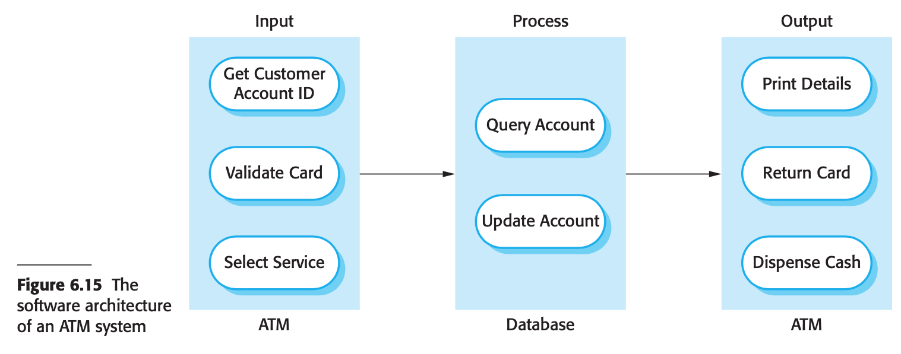

Slide 15
KEY POINTS - Software Architecture
A software architecture is a description of how a software system is organized. Properties of a system such as performance, security, and availability are influenced by the architecture used.
Architectural design decisions include decisions on the type of application, the distribution of the system, the architectural styles to be used, and the ways in which the architecture should be documented and evaluated.
Architectures may be documented from several different perspectives or views. Possible views include a conceptual view, a logical view, a process view, a development view, and a physical view.
Architectural patterns are a means of reusing knowledge about generic system architectures. They describe the architecture, explain when it may be used, and discuss its advantages and disadvantages.
Commonly used architectural patterns include Model-View-Controller, Layered Architecture, Repository, Client–server, and Pipe and Filter.
Generic models of application systems architectures help us understand the operation of applications, compare applications of the same type, validate application system designs, and assess large-scale components for reuse.

Slide 16
Activity 1: Collaborative System Design Exercise
Objective: Apply architectural, component, data, and interface design principles to a real-world problem.
Work in the same team during Masjid Tour.
Project scenario – Smart Operations Management System for Masjid
Work on the following tasks:
  Architectural Design: Choose an architectural style (e.g., client-server, microservices) and sketch a high-level design.
  Component Design: Break down the system into major components/modules and define the responsibilities of each.
  Data Design: Design the data structures, including database schema and data flow diagrams. Ensure they include considerations for data integrity and security.
  Interface Design: Define how different system components will interact, ensuring smooth communication between modules.
Presentation: Teams will present their designs, explaining the rationale behind their architectural and component choices, data structures, and interface communication.

Slide 17
Objectives - Software Testing
understand the stages of testing from testing, during development to acceptance testing by system customers;
have been introduced to techniques that help you choose test cases that are geared to discovering program defects;
understand test-first development, where you design tests before writing code and run these tests automatically;
know the important differences between component, system, and release testing and be aware of user testing processes and techniques.

Slide 18
What is testing?
Testing is intended to show that a program does what it is intended to do and to discover program defects before it is put into use.
When you test software, you execute a program using artificial data.
You check the results of the test run for errors, anomalies, or information about the program’s non-functional attributes.

Slide 19
Testing process has two distinct goals:
To demonstrate to the developer and the customer that the software meets its requirements.
  For custom software, this means that there should be at least one test for every requirement in the requirements document.
  For generic software products, it means that there should be tests for all of the system features, plus combinations of these features, that will be incorporated in the product release.
To discover situations in which the behavior of the software is incorrect, undesirable, or does not conform to its specification.
  Consequence of software defects:
    undesirable system behavior such as system crashes, unwanted interactions with other systems, incorrect computations, and data corruption.

Slide 20
Verification and validation processes
Verification and validation processes are concerned with checking that software being developed meets its specification and delivers the functionality expected by the users
Validation: Are we building the right product?
  To check that the software meets its stated functional and non-functional requirements
Verification: Are we building the product right?
  To ensure that the software meets the customer’s expectations.
Involve software inspections and reviews.
  Inspections and reviews analyze and check the system requirements, design models, the program source code, and system tests.

Slide 21
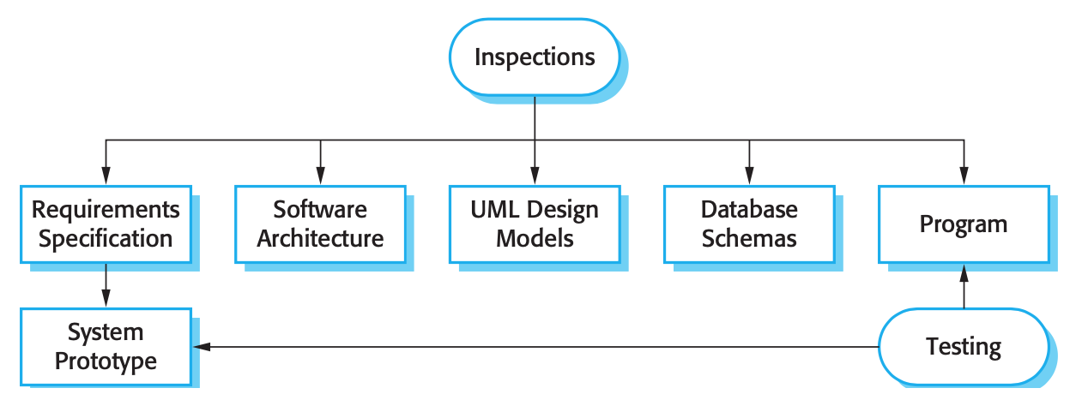
Inspection & Testing

Slide 22
Three stages of testing
Development testing, where the system is tested during development to discover bugs and defects. System designers and programmers are likely to be involved in the testing process.
Release testing, where a separate testing team tests a complete version of the system before it is released to users. The aim of release testing is to check that the system meets the requirements of system stakeholders.
User testing, where users or potential users of a system test the system in their own environment. For software products, the ‘user’ may be an internal marketing group who decide if the software can be marketed, released, and sold. Acceptance testing is one type of user testing where the customer formally tests a system to decide if it should be accepted from the system supplier or if further development is required.

Slide 23
Development testing
Unit testing, where individual program units or object classes are tested. Unit testing should focus on testing the functionality of objects or methods.
Component testing, where several individual units are integrated to create composite components. Component testing should focus on testing component interfaces.
System testing, where some or all of the components in a system are integrated and the system is tested as a whole. System testing should focus on testing component interactions.

Slide 24
Release testing
The process of testing a particular release of a system that is intended for use outside of the development team.
Normally, the system release is for customers and users.
In a complex project, however, the release could be for other teams that are developing related systems.
For software products, the release could be for product management who then prepare it for sale.

Slide 25
User testing
User / customer testing is a stage in the testing process in which users or customers provide input and advice on system testing.
User testing is essential, even when comprehensive system and release testing have been carried out.
The reason for this is that influences from the user’s working environment have a major effect on the reliability, performance, usability, and robustness of a system.

Slide 26
Three different types of user testing
Alpha testing, where users of the software work with the development team to test the software at the developer’s site.
Beta testing, where a release of the software is made available to users to allow them to experiment and to raise problems that they discover with the system developers.
Acceptance testing, where customers test a system to decide whether or not it is ready to be accepted from the system developers and deployed in the customer environment.

Slide 27
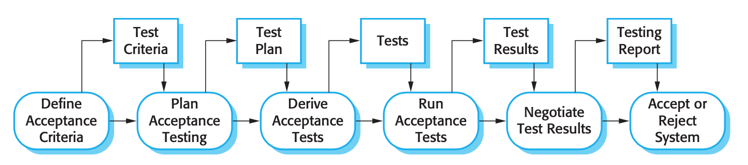
The acceptance testing process

Slide 28
KEY POINTS – Software Testing
Testing can only show the presence of errors in a program. It cannot demonstrate that there are no remaining faults.
Development testing is the responsibility of the software development team. A separate team should be responsible for testing a system before it is released to customers. In the user testing process, customers or system users provide test data and check that tests are successful.
Development testing includes unit testing, in which you test individual objects and methods; component testing, in which you test related groups of objects; and system testing, in which you test partial or complete systems.
When testing software, you should try to ‘break’ the software by using experience and guidelines to choose types of test cases that have been effective in discovering defects in other systems.
Wherever possible, you should write automated tests. The tests are embedded in a program that can be run every time a change is made to a system.
Test-first development is an approach to development where tests are written before the code to be tested. Small code changes are made and the code is refactored until all tests execute successfully.
Scenario testing is useful because it replicates the practical use of the system. It involves inventing a typical usage scenario and using this to derive test cases.
Acceptance testing is a user testing process where the aim is to decide if the software is good enough to be deployed and used in its operational environment.

Slide 29
References
Sommerville, I. (2016). Software engineering. Pearson.

